Slide 1
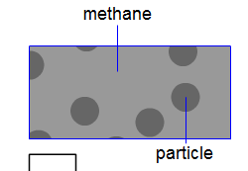
Empty space
Imagine you could see the particles in this jar of methane gas.
Which diagram best matches what you would see?
A
B
C
D
E

